Slide 1
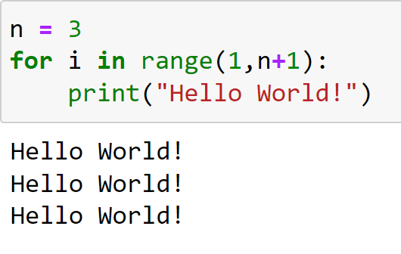
Multiple Condition IF Statements Programming and Algorithms
Lecture by
Dr Daniil Osudin

Slide 3
What will we Cover?
IF statements with multiple conditions
Writing programs to perform conditional execution

Slide 4
Multiple Condition IF Statements
Boolean expressions can be combined using the Logical Operators or, and, not within the condition of an IF or ELIF Statement
Examples
If you cook dish A or dish B, pre-heat the oven to 200º, otherwise 180º is sufficient
If you turn left and then turn right at the next crossing you will get to town A
Bob will go to the office today if it is a weekday and he is not sick

Slide 5
Multiple Condition IF Statements in Python
Body 1 is executed if both conditions evaluate to True
if <condition 1 and condition 2>:
body 1
else:
body 2
One or multiple statements in each body.
Body 2 is executed if either condition evaluates to False

Slide 6
Nested IF Statements Flow Chart
start
read x
x = int(input())
if(x > 0 and x < 5):
print(x, "is in the range")
else:
print(x, "is not in the range")
x > 0 and x < 5?
No
Yes
print message 2
print message 1
end

Slide 7
Multiple Condition IF Statements in Python
Body 1 is executed if either condition evaluates to True
if <condition 1 or condition 2>:
body 1
else:
body 2
One or multiple statements in each body.
Body 2 is executed if both condition evaluate to False

Slide 8
Nested IF Statements Flow Chart
start
read x
x = int(input())
if(x <= 0 or x >= 5):
print(x, "is not in the range")
else:
print(x, "is in the range")
x <= 0 or x >= 5?
No
Yes
print message 2
print message 1
end

Slide 9
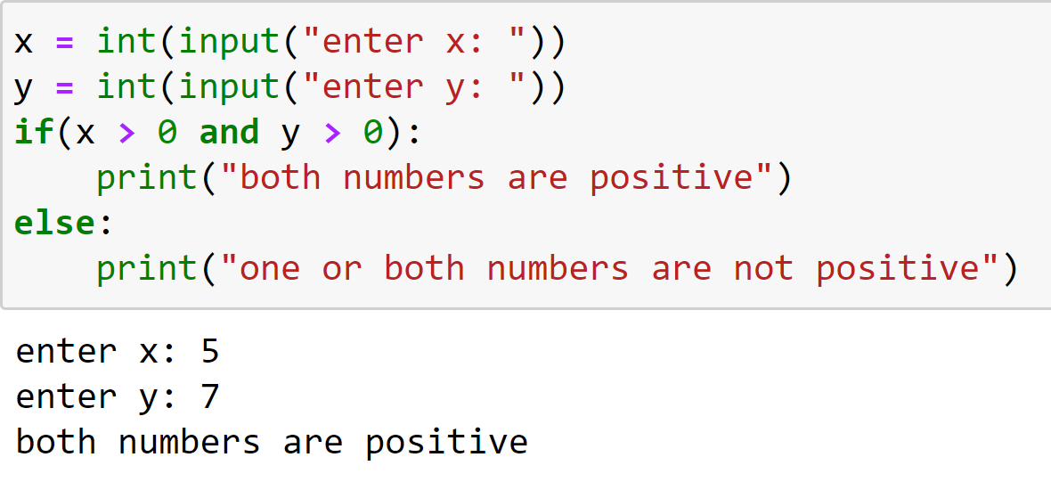
Examples
Condition 2 true
Condition 1 true

Slide 10
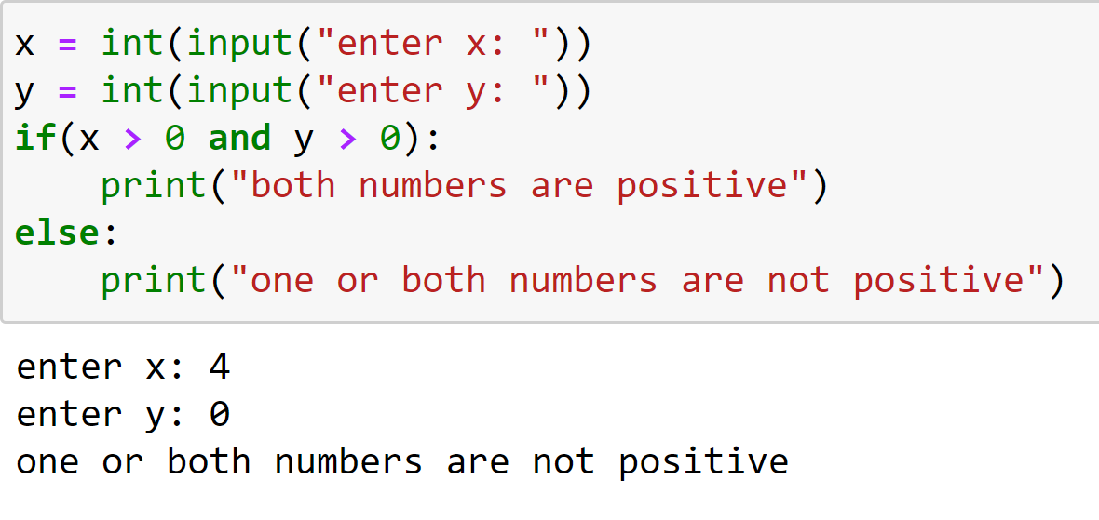
Examples
Condition 2 false
Condition 1 true

Slide 11
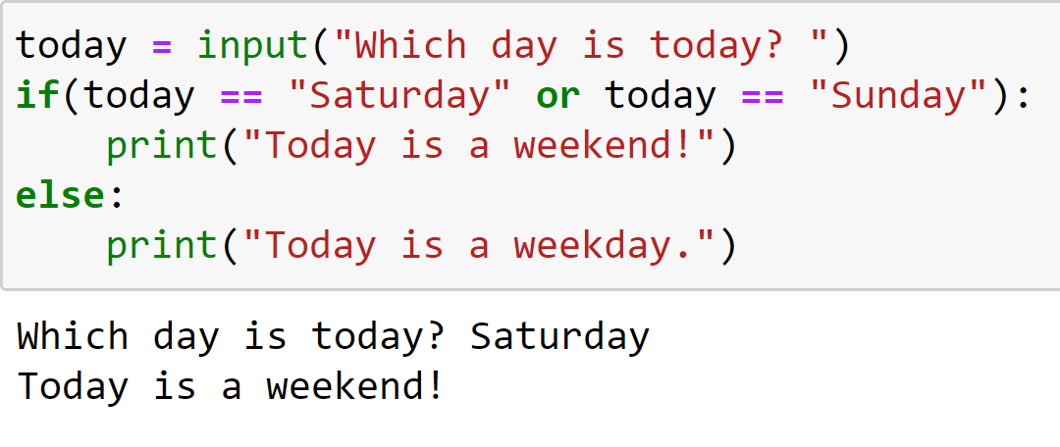
Examples
Condition 1 true
Condition 2 false

Slide 12
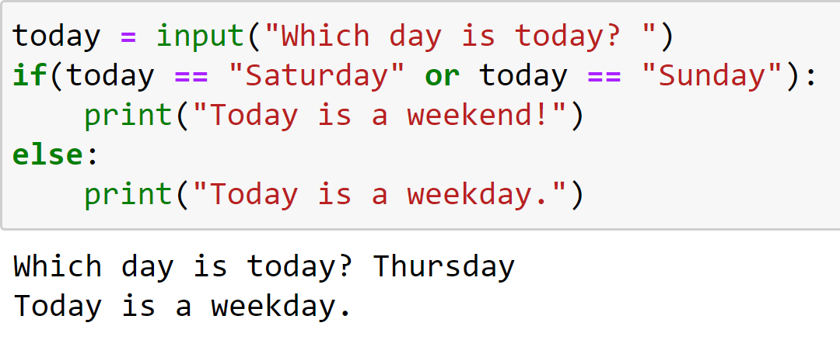
Examples
Condition 1 false
Condition 2 false

Slide 13
Try It Yourself
Write the following in the python environment:
A program that takes two integers as inputs and outputs the sum of the integers if both are positive or “incorrect input” message otherwise

Slide 14
Try It Yourself
Write the following in the python environment:
A program that outputs the number of days in a given month (assume that it is not a leap year)

